Slide 1


Slide 2


Distiller’s Dried Grains with Soluble As Animal Feed
DDGS
Dr. Morteza Rezaee
Consultant of Ghazelle Development Holding
17-18 July 2023, Tehran
Notes:
This template is provided by http://www.free-power-point-templates.com/

Slide 3
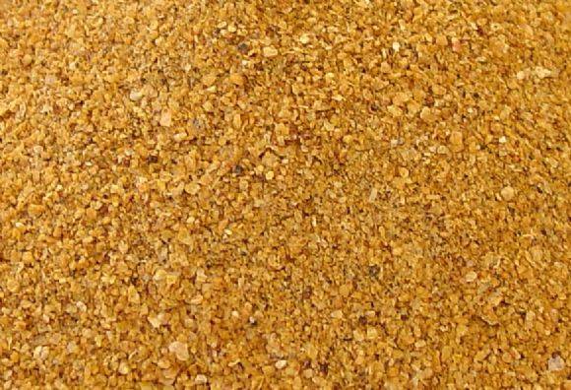
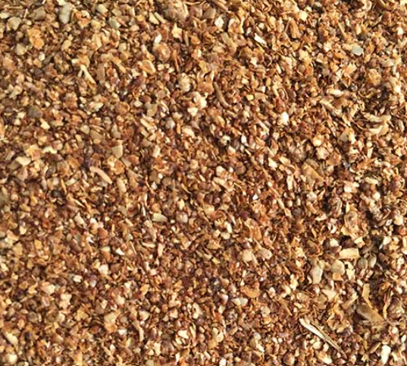
Distillers Dried Grains with Soluble (DDGS)
is one of the co-products of dry milling industry and consists of undigested grain components resulting from grain ethanol fermentation.
Corn DDGS
Wheat DDGS

Slide 4
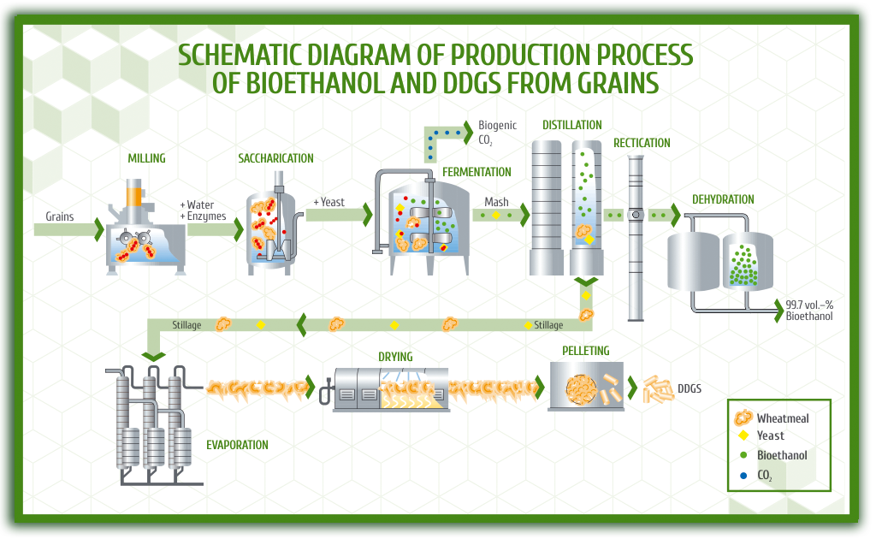
Slide Title
Product A
Product B
Feature 1
Feature 2
Feature 3
Feature 1
Feature 2
Feature 3

Slide 5
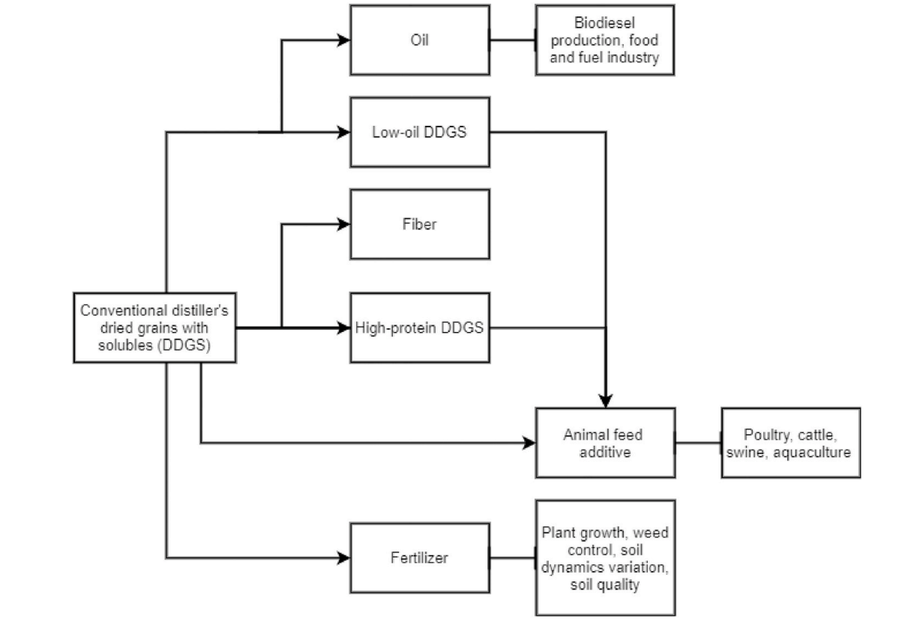
Current uses of DDGS

Slide 6
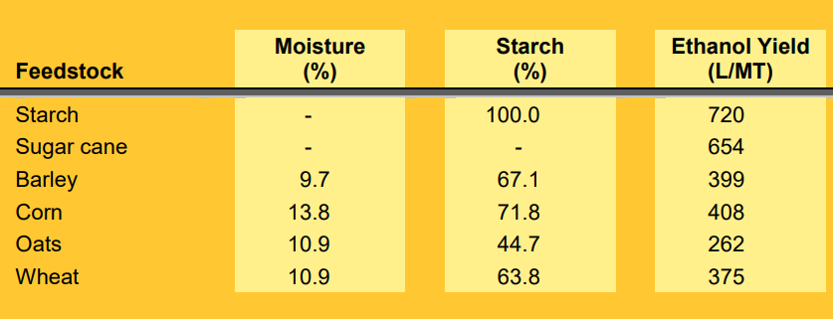
Starch content and ethanol yield of various feedstocks

Slide 7
Efficiency Rate
408_{(l)} ethanol
1000_{(Kg)} corn
255_{(Kg)} DDGS
408_{(l)} CO₂

Slide 8
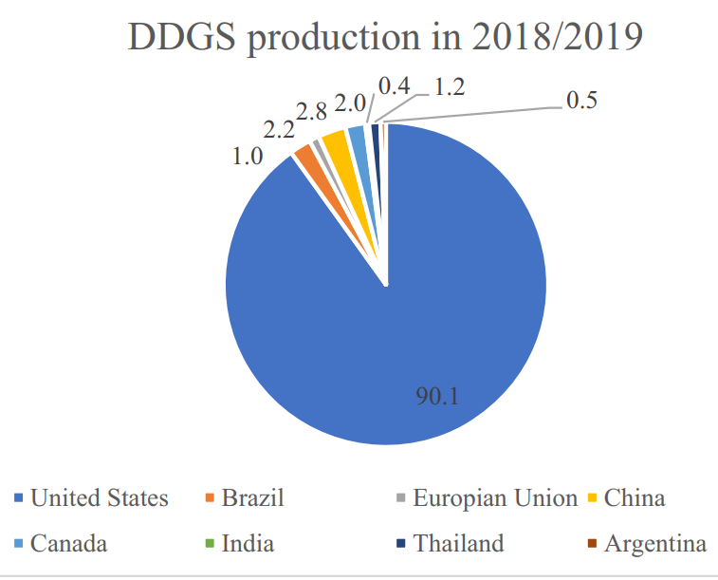
DDGS production in 2018/2019

Slide 9
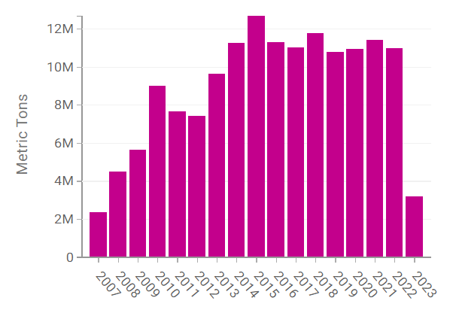
U.S. Annual Exports of DDGS

Slide 10
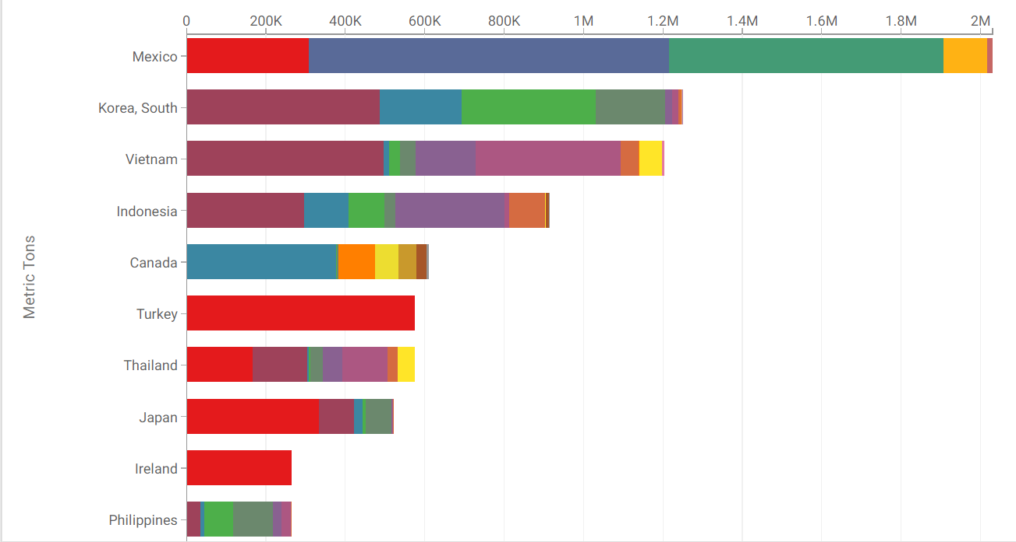
Top 10 Destinations for U.S. DDGS Exports, by Export District

Slide 11
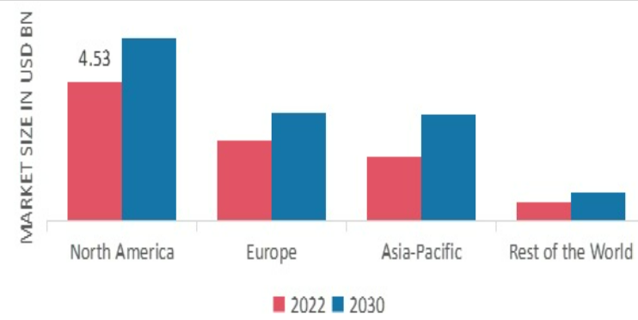
DDGS Market share by region 2022

Slide 12
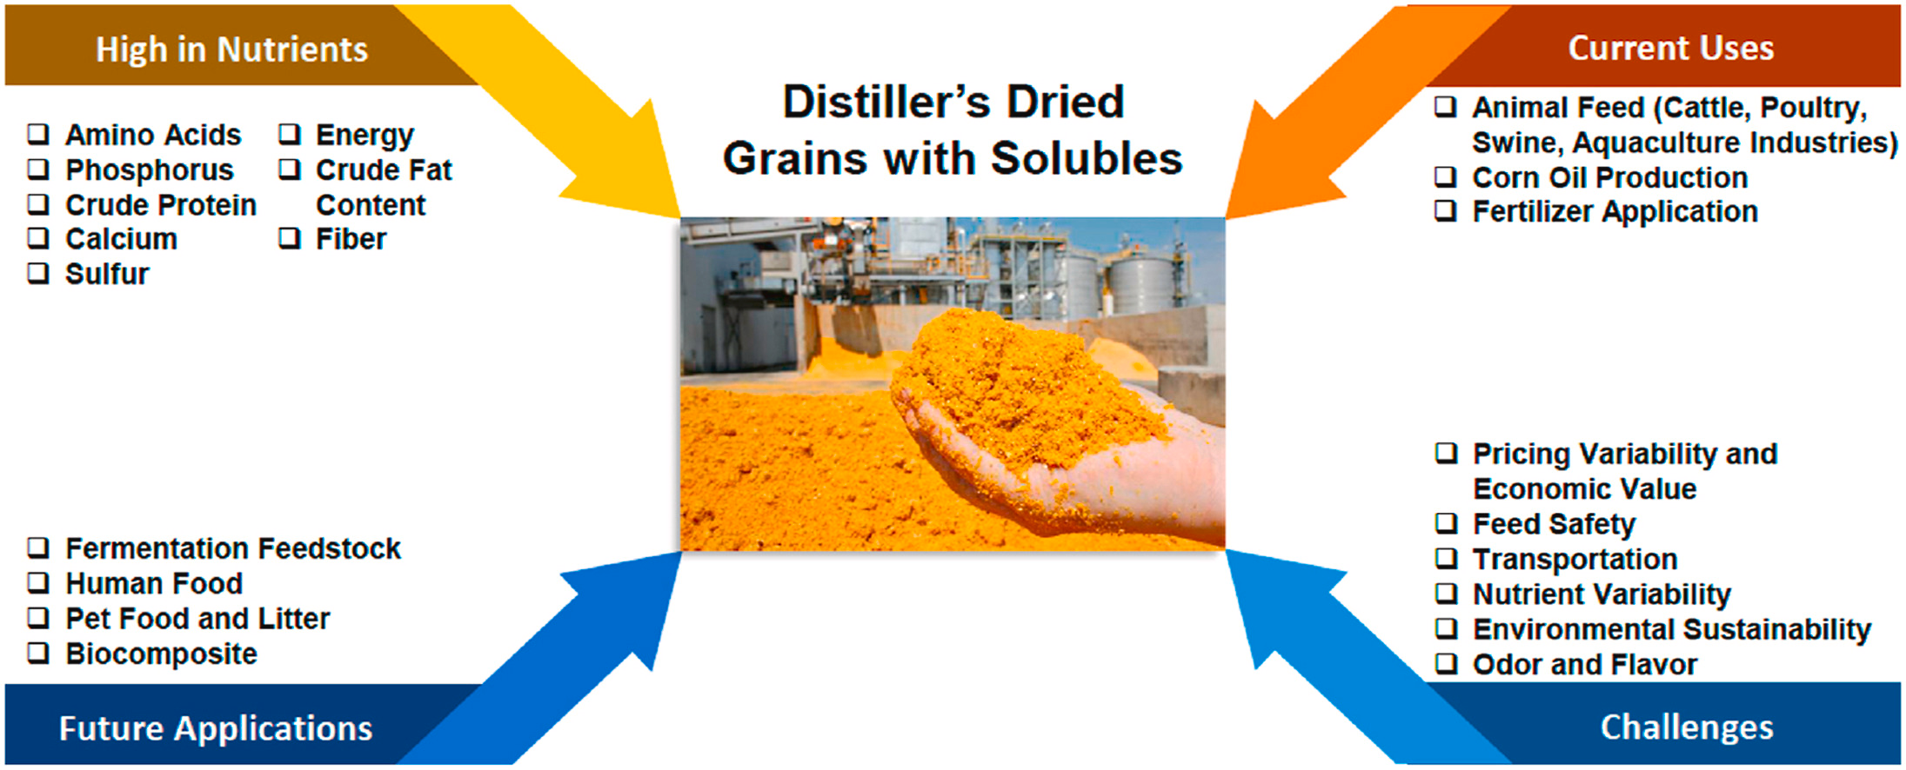

Slide 13
DDGS AS Animal Feed
DDGS is good source of protein, calcium, phosphorus, and sulfur

Slide 14

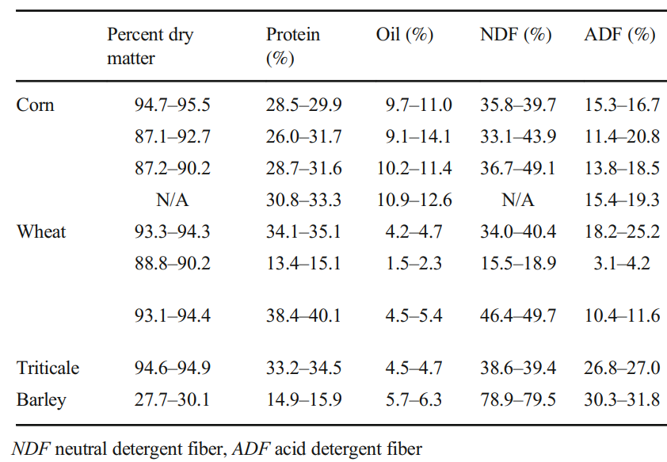
Nutrient variability in DDGS based on feedstock grain

Slide 15
DDGS As Animal Feed
DDGS can partially replace some of the expensive feedstuffs such as:
Energy source: Corn and Barley
Protein source: Soybean Meal
UDP source: Fish Meal
P source: DCP&MCP

Slide 16
Chemical Composition and Nutritive value
Chemical characteristics of DDGS are affected by source and process:
Types of grains
Grain variety
Grain quality
Particle size
Drying method
Temperature and time
Yeast quality and quantity
Amount of syrup mixed with grain
Use of centrifuges
…

Slide 17
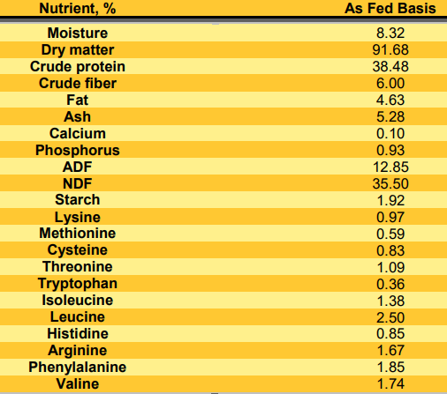


Nutrient composition of wheat DDGS

Slide 18
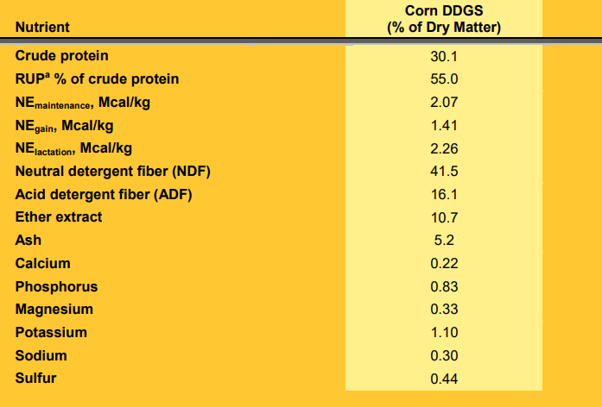

Nutrient composition of corn DDGS for dairy cattle

Slide 19
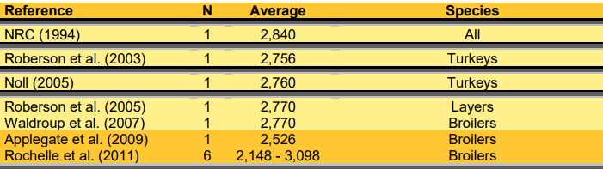
Apparent metabolizable energy content of DDDGS in poultry (kcal/kg)

Slide 20
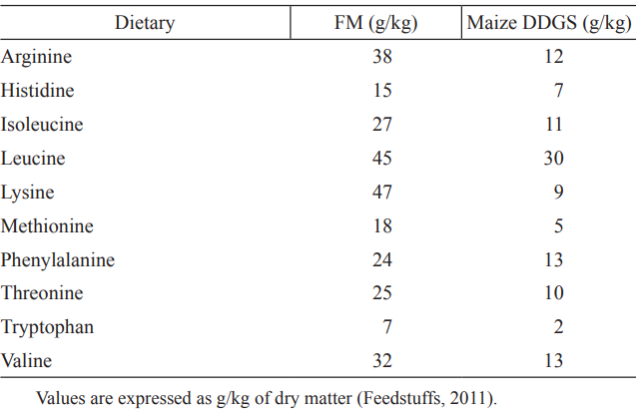
The essential amino acid composition of menhaden fish meal (FM) and maize DDGS (g/kg)

Slide 21
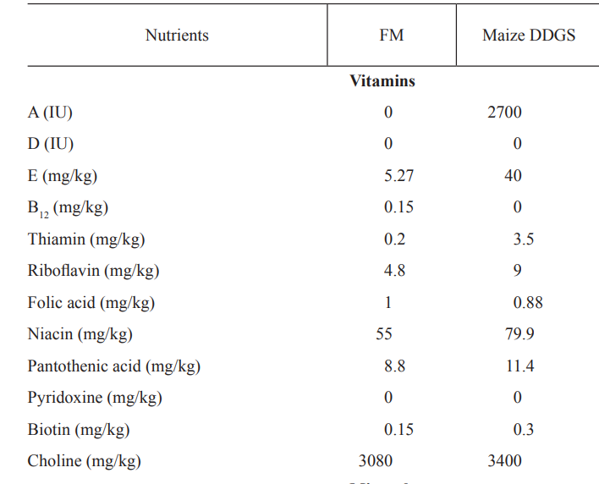

Vitamin content of menhaden fish meal (FM) and maize DDGS

Slide 22

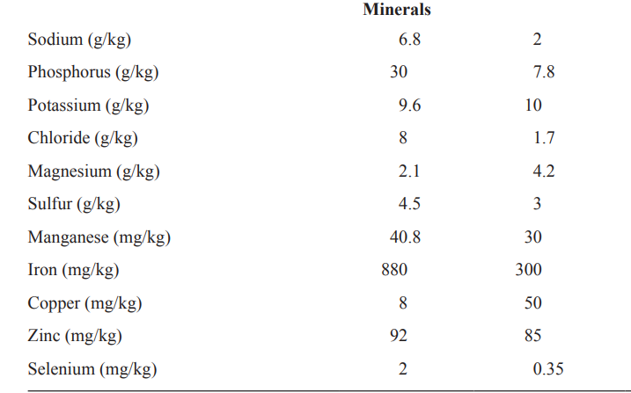
Mineral content of menhaden fish meal (FM) and maize DDGS

Slide 23

Storage Stability
Moisture:10 to 12% “Clumping” or “caking”
Fat oxidation:

Slide 24
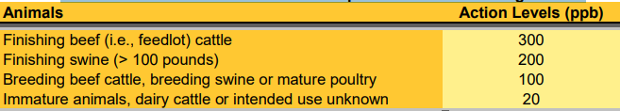
Mycotoxins in DDGS
Mycotoxins are secondary metabolites produced by filamentous fungi, highly toxic to animals, and structurally diverse
FDA action levels for aflatoxin in complete feeds and feed ingredients

Slide 25








A Glance At Gazelle Development Holding

Slide 26

Thank you for Your Attention
Questions?

